Slide 1

Data-Driven Analysis of Shooting Incident Fatalities
Introduction Research Project
Alwin T
Data Science Intern @ Spinnaker Analytics

Slide 2

Agenda
Introduction
Project Significance
Data Collection
Data Analysis
Exploratory Data Analysis
Data Cleaning
Outlier Detection
Outlier Treatment
Outlier Removal Before & After
Split Train and Test Data
Data Standardization
Model Training & Model Evaluation
Choosing Best Model
Deployment

Slide 3

Introduction
The public safety sector is evolving rapidly, influenced by technological advancements, changing urban dynamics, and a growing need for data-driven decision-making.
Shooting incidents, particularly the fatal ones, pose significant challenges and opportunities for law enforcement agencies.
When a shooting incident results in a fatality, it has a profound impact on community safety, public trust, and the strategic allocation of police resources.
Machine learning, with its predictive capabilities, offers a transformative approach to understanding and mitigating the challenges posed by shooting incidents.

Slide 4

Project Significance
Enhanced Community Safety:
Anticipating fatal incidents allows for proactive strategies, improving response times and community safety.
Resource Optimization:
Predicting and mitigating fatal incidents is cost-effective ensuring
efficient allocation and utilization of police resources.
Risk Mitigation:
Identifying potential fatal incidents mitigates risks, enabling preventive measures and strategic interventions

Slide 5
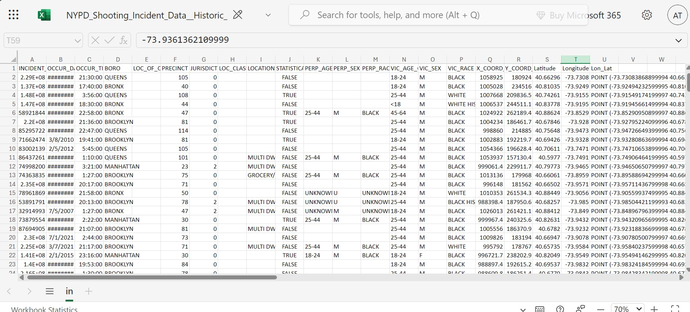
Data Collection

Slide 6

Cont....
Dataset Overview:
The dataset used is titled: "NYPD Shooting Incident Data (Historic)".
It contains information on historic shooting incidents recorded by the NYPD.
Source of Data :
Dataset obtained from Spinnaker Analytics Open Data Portal.
Key Features in the Dataset:
Highlight important columns in the dataset:
Incident Occurrence Details: Date, Time, Borough, Location.
Perpetrator Information: Age, Sex, Race.

Slide 7

Cont....
Victim Information: Age, Sex, Race.
Geographical Data: Latitude, Longitude, and Coordinates.
These features are critical for analysis and classification.
Dataset Size
Total number of records and features (rows and columns).
Example: "The dataset contains thousands of records across 18 attributes."
Purpose of Dataset
The dataset is used to predict and classify the fatality outcome in shooting incidents.
It combines demographic, geographical, and incident-specific data for analysis.

Slide 8

Data Analysis
Dataset Summary:
The dataset contains 27,312 entries and 21 columns.
Data types include:
Numerical Columns: int64 and float64 (e.g., Latitude, Longitude, X_COORD_CD).
Categorical Columns: object (e.g., BORO, PERP_RACE, VIC_RACE).
Boolean Column: STATISTICAL_MURDER_FLAG.
Memory Usage
The dataset occupies 4.2 MB in memory.

Slide 9

Cont...
Column Information:
Important columns include:
Incident Details: INCIDENT_KEY, OCCUR_DATE, OCCUR_TIME, BORO.
Victim Information: VIC_AGE_GROUP, VIC_SEX, VIC_RACE.
Perpetrator Information: PERP_AGE_GROUP, PERP_SEX, PERP_RACE.
Geographical Information: Latitude, Longitude, X_COORD_CD, Y_COORD_CD.
Null Values:
Some columns have significant missing values:
LOC_OF_OCCUR_DESC: 25,596 missing values.
LOC_CLASSFCTN_DESC: 25,596 missing values.
LOCATION_DESC: 14,977 missing values.
PERP_AGE_GROUP, PERP_SEX, PERP_RACE: Over 9,000 missing values each.
Minimal missing values in geographical coordinates (Latitude and Longitude with 10 missing values).

Slide 10
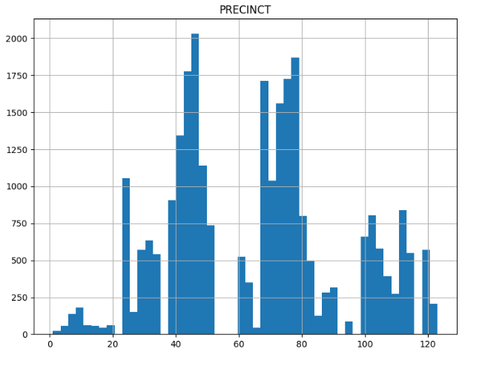
Exploratory Data Analysis
PRECINCT Distribution:
The data shows that certain precincts (e.g., around 40–50 and 70–80) have significantly more incidents compared to others.
Some precincts have very low or no activity, indicating areas with minimal incidents or gaps in data collection.
This highlights potential hotspots for incidents and areas requiring focused attention or further investigation.

Slide 11
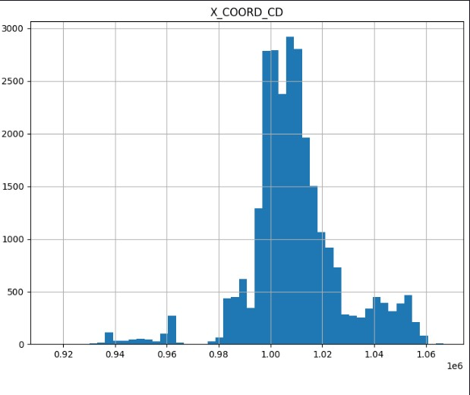
Cont...
X_COORD_CD Distribution:
The histogram indicates that most incidents are concentrated in a narrow range of X_COORD_CD values.
This suggests a geographic clustering of incidents along a specific longitude range.
Outliers on either side indicate isolated incidents outside the main clusters.

Slide 12
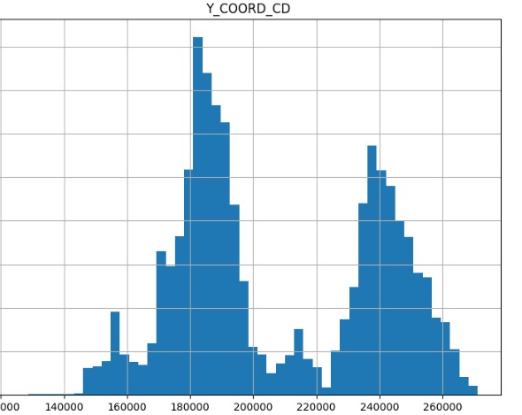
Cont...
Y_COORD_CD Distribution
Similar to X_COORD_CD, the Y_COORD_CD values show two distinct peaks, suggesting two main clusters of incidents along the latitude axis.
This could indicate specific zones or neighborhoods experiencing higher concentrations of incidents.

Slide 13

Data Cleaning
Dropping Unnecessary Columns:
Removed columns such as OCCUR_DATE, OCCUR_TIME, BORO, and others to focus on relevant data for analysis and reduce noise.
Eliminating Unique Identifiers:
Dropped INCIDENT_KEY as it does not contribute to meaningful insights.
Converting Boolean Values:
Transformed the STATISTICAL_MURDER_FLAG column from Boolean (True/False) to numerical (1/0) for consistency in analysis.
Reorganizing Column Order:
Adjusted column positions to bring important features into focus.

Slide 14

Cont...
Handling Missing Values:
Identified missing values in key columns: Latitude, Longitude, and JURISDICTION_CODE.
Imputed missing values using the median to maintain robustness and avoid skewing the data.
Prepared Data for Further Analysis:
Ensured all columns are clean, consistent, and ready for modeling or visualization.

Slide 15
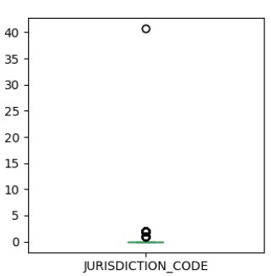
Outlier Detection
JURISDICTION_CODE:
The distribution is highly skewed with most values clustered around 0.
There are a few outliers above 0.

Slide 16
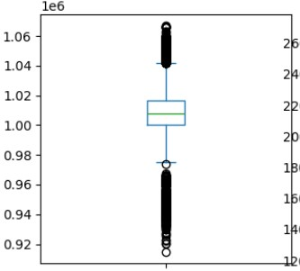
Cont....
X_COORD_CD:
The values range from approximately 0.92e6 to 1.06e6.
The median is around 1.02e6.
Numerous outliers exist on both the lower and upper ends.

Slide 17
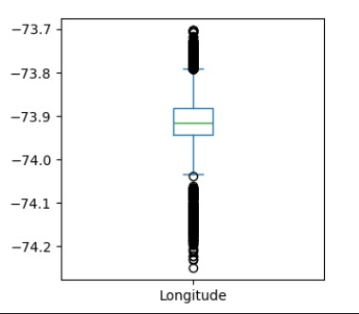
Cont....
Longitude:
The values range from approximately -74.2 to -73.7.
The median is around -73.9.
Numerous outliers exist on both the lower and upper ends.

Slide 18

Outlier Treatment
Isolation Forest Algorithm:
Utilized the Isolation Forest technique for outlier detection.
Suitable for identifying anomalies in high-dimensional datasets.
Contamination Parameter:
Set contamination parameter to 0.05, indicating that 5% of the data is expected to be outliers.
Outlier Detection Process:
The fit_predict method was applied to the scaled dataset X_scaled to identify outliers.
Outliers are marked with -1, and inliers with 1.

Slide 19

Cont...
Mask Creation:
Created a mask to filter out the outliers (mask = outliers != -1).
Cleaned Dataset:
Applied the mask to obtain the cleaned dataset X_clean and corresponding target variable y_clean.
This process helps in improving the robustness of the model by removing anomalous data points.
Benefits of Outlier Removal:
Enhances model performance and accuracy.
Reduces noise and potential biases in the data.
Facilitates more reliable and interpretable results.

Slide 20
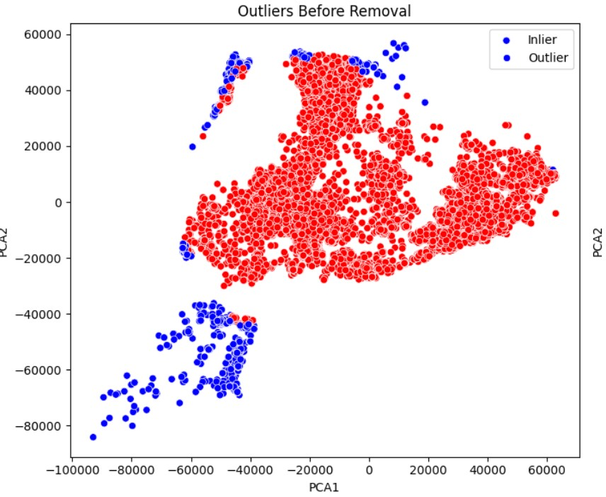
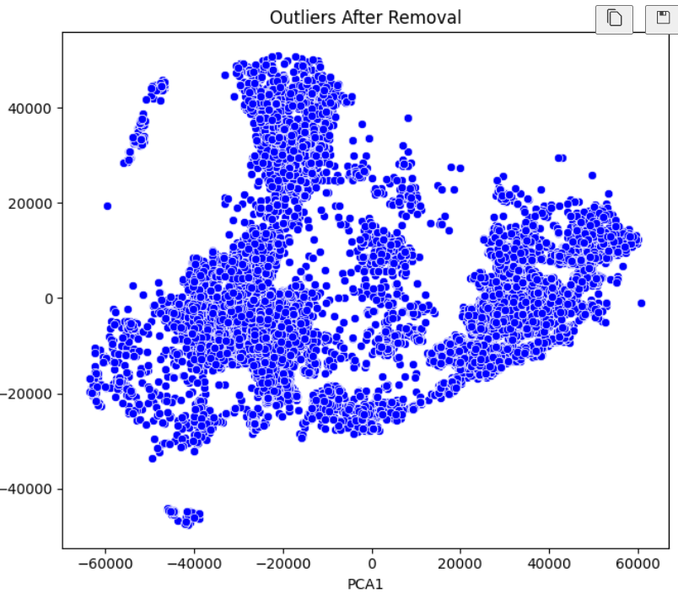
Outlier Removal Before & After
Before
After

Slide 21

Split Train and Test Data
Purpose of Train/Test Split:
To evaluate the performance of the model by training it on one portion of the data and testing it on another.
Helps in assessing the model's ability to generalize to unseen data.
Splitting the Data:
Used the train_test_split function from sklearn.model_selection to divide the data.
The dataset is split into training and testing sets.
Training Set:
80% of the data is used for training.
Size of the training set: 21,849 samples (approx).

Slide 22

Data Standardization
Shapes of Transformed Data:
X_train_scaled: Shape (21849, 6) indicates that the training data has 21,849 samples, each with 6 features, after scaling.
X_test_scaled: Shape (5463, 6) similarly confirms that the test set has 5,463 samples with 6 features
Shapes of Target Variables:
y_train and y_test are unmodified (labels are not scaled), with shapes (21849,) and (5463,), respectively. This indicates they are 1D arrays of labels corresponding to the training and test data.
Sample Transformed Data (X_train_scaled):
The transformed training data has been standardized. Each feature now has a mean of approximately 0 and a standard deviation of 1, calculated from the training data.

Slide 23

Model Training & Model Evaluation
Models Used:
Logistic Regression: A linear model for classification based on probabilities.
Decision Tree: A tree-based model that splits data based on feature thresholds.
Random Forest: An ensemble of decision trees for better accuracy and robustness.
Support Vector Machine (SVM): A model that finds the optimal hyperplane for classification.
Gradient Boosting: A boosting algorithm that combines weak learners iteratively to improve predictions.

Slide 24
Cont...
Model | Accuracy | Precision | Recall | F1-Score | TP | FN | FP | TN
Logistic Regression | 0.7742 | 0.7053 | 0.7742 | 0.7305 | 3935 | 282 | 890 | 83
Decision Tree | 0.7742 | 0.7053 | 0.7742 | 0.7305 | 3935 | 282 | 890 | 83
Random Forest | 0.7742 | 0.7053 | 0.7742 | 0.7305 | 3935 | 282 | 890 | 83
Support vector Machine (SVM) | 0.7742 | 0.7053 | 0.7742 | 0.7305 | 3935 | 282 | 890 | 83
Gradient Boosting | 0.7742 | 0.7053 | 0.7742 | 0.7305 | 3935 | 282 | 890 | 83

Slide 25

Choosing Best Model
Best Performing Model:
Logistic Regression was identified as the best model based on evaluation metrics.
Consistency Across Models:
All models demonstrated identical performance metrics, indicating robust and reliable results.
Interpretability and Simplicity:
Logistic Regression is preferred due to its simplicity and ease of interpretability, making it suitable for understanding and explaining model predictions.
Practical Application:
This model's straightforward approach allows for clear insights and actionable decisions, beneficial in a real-world business context.

Slide 26
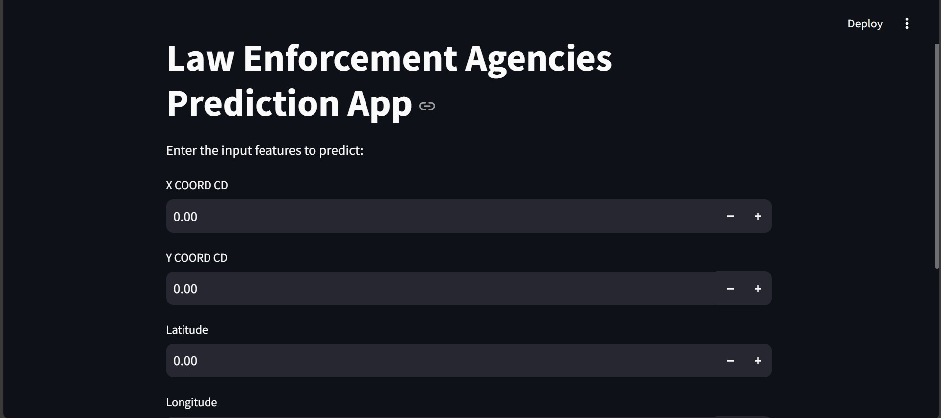
Deployment
Successfully Deployed the Model as a Web Application Using Streamlit.

Slide 27

THANK YOU !

